Slide 1

Foundations of Machine Learning DSA 5105 • Lecture 6
Soufiane Hayou
Department of Mathematics

Slide 2
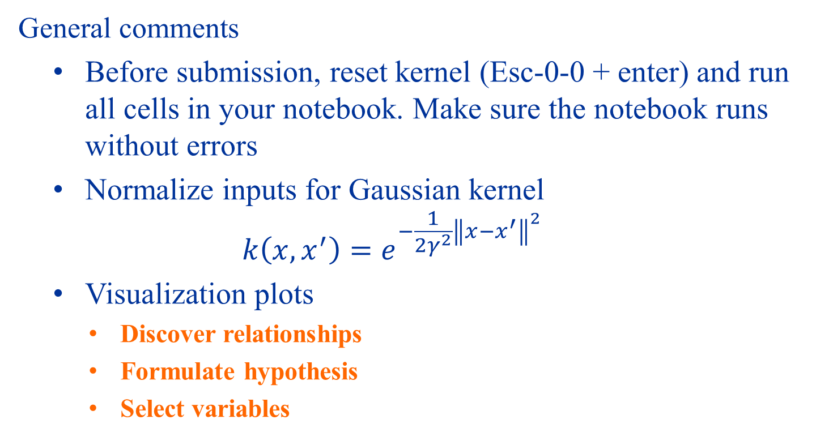
Homework 1
General comments
Before submission, reset kernel (Esc-0-0 + enter) and run all cells in your notebook. Make sure the notebook runs without errors
Normalize inputs for Gaussian kernel $k\left(x,x^{′}\right)=e^{−\frac{1}{2γ^{2}}{\left\|x−x^{′}\right\|}^{2}}$
Visualization plots
Discover relationships
Formulate hypothesis
Select variables

Slide 3
Last time
We introduced
Neural networks
Universal/nonlinear approximation
Shallow and deep networks
Optimization of deep neural networks
Gradient Descent
SGD, interaction with learning rates and batch sizes
Today, we will look at some modern architectures that are very useful for practical applications, and the key ideas behind them

Slide 4
What’s Wrong with FCNNs?

Slide 5
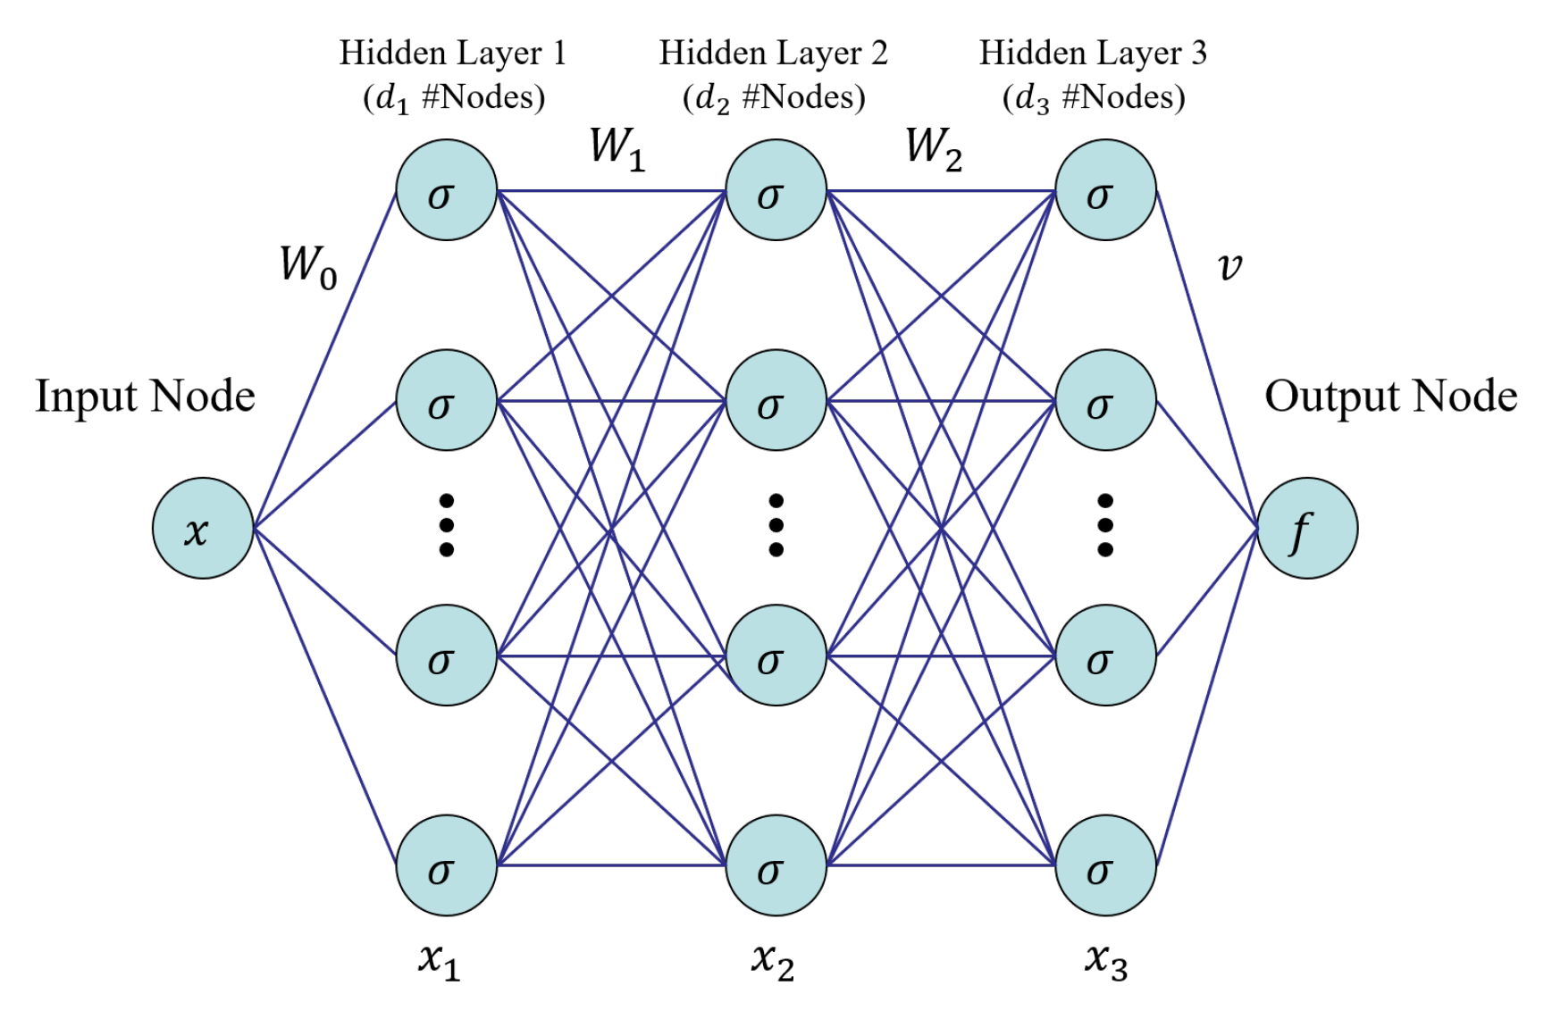
Recall The Fully Connected NN Architecture

Slide 6
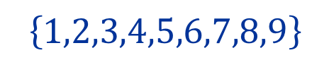
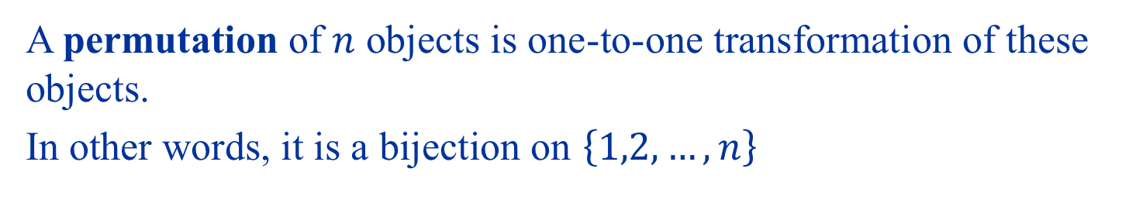
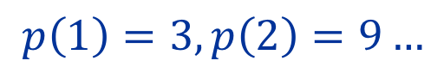

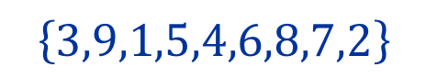
Permutations
A permutation of $n$ objects is one-to-one transformation of these objects.
In other words, it is a bijection on $\left\{1,2,…,n\right\}$
$$\left\{1,2,3,4,5,6,7,8,9\right\}$$
$$p$$
$$p\left(1\right)=3, p\left(2\right)=9…$$
$$\left\{3,9,1,5,4,6,8,7,2\right\}$$

Slide 7
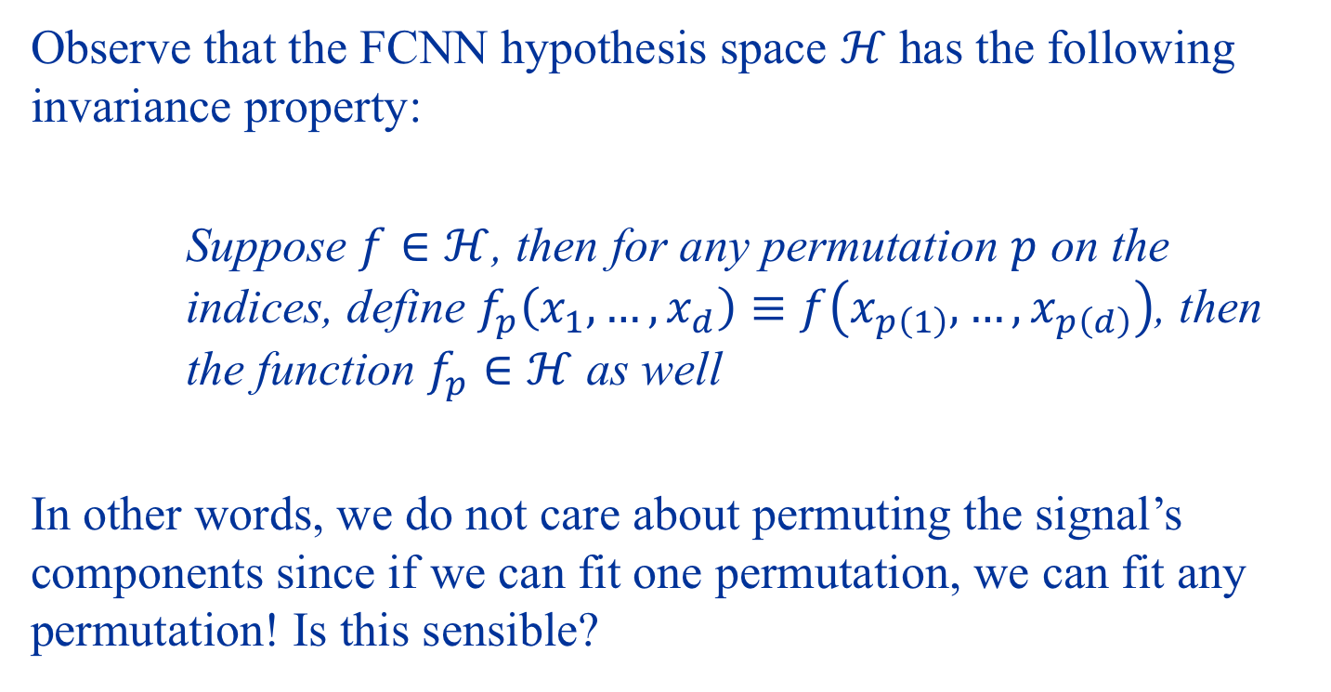
Permutation Invariance
Observe that the FCNN hypothesis space $ℋ$ has the following invariance property:
Suppose $f∈ℋ$, then for any permutation $p$ on the indices, define $f_{p}\left(x_{1},…,x_{d}\right)≡f\left(x_{p\left(1\right)},…,x_{p\left(d\right)}\right)$, then the function $f_{p}∈ℋ$ as well
In other words, we do not care about permuting the signal’s components since if we can fit one permutation, we can fit any permutation! Is this sensible?

Slide 8
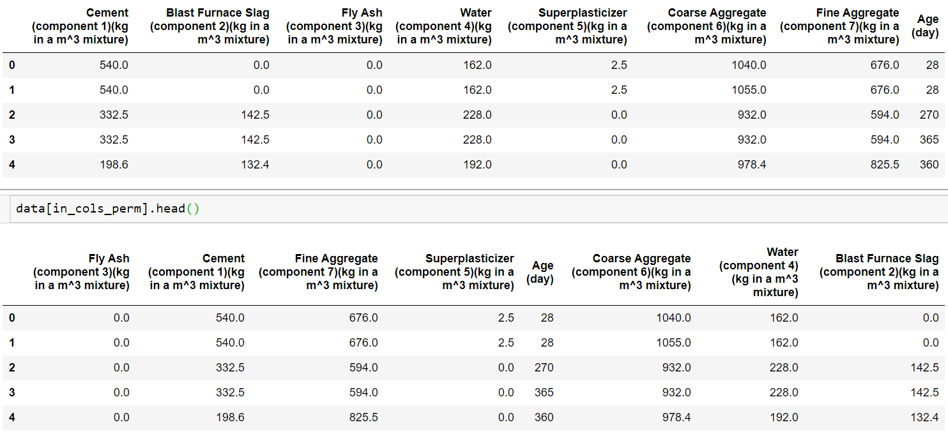
Random Permutation

Slide 9
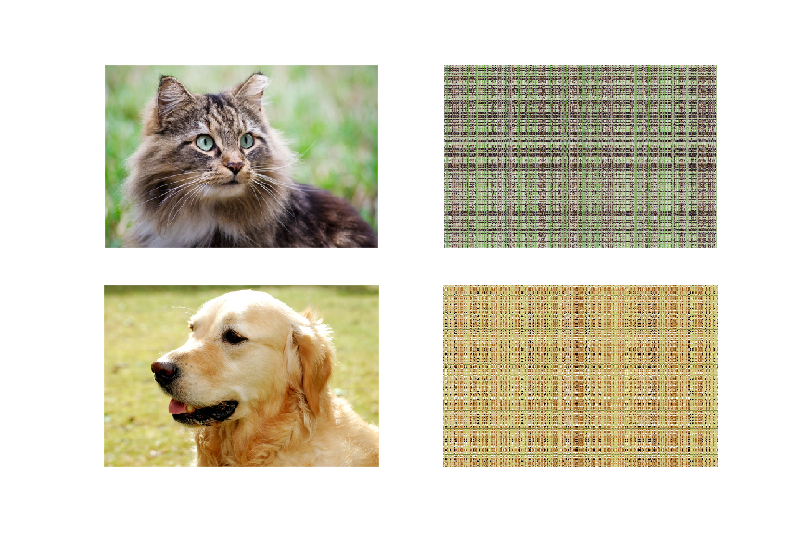
Random Permutation

Slide 10
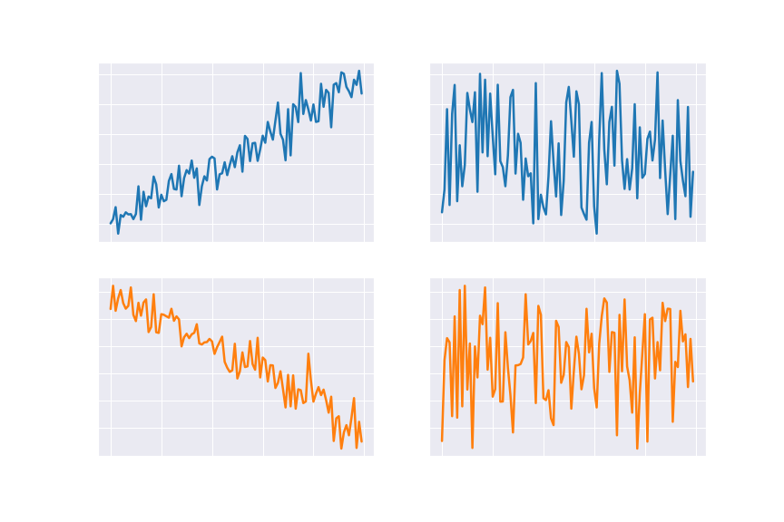
Random Permutation

Slide 11
Limitation of FCNN The permutation invariance property loses spatial/temporal structure in the data!

Slide 12
Convolutional Neural Networks

Slide 13
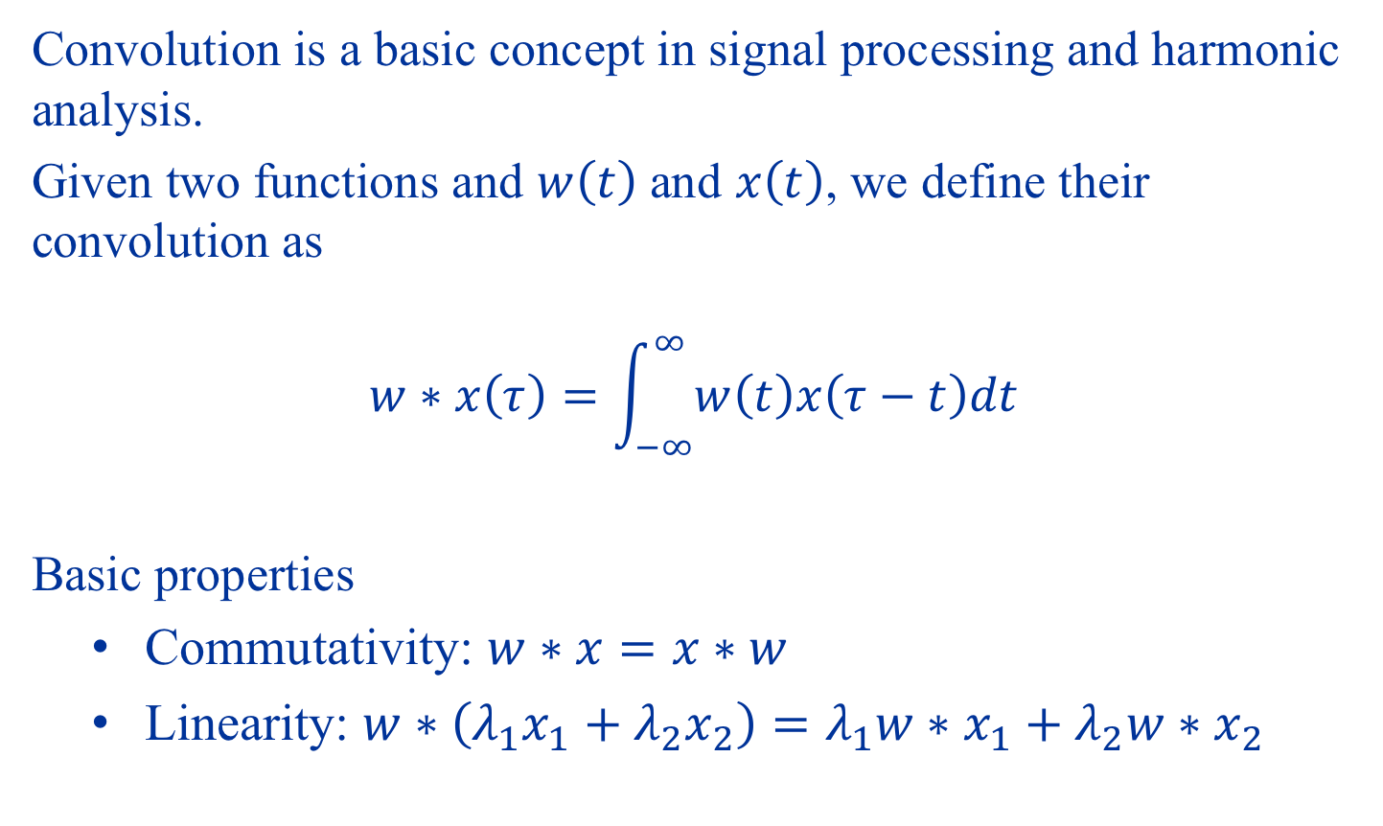
Convolutions
Convolution is a basic concept in signal processing and harmonic analysis.
Given two functions and $w\left(t\right)$ and $x\left(t\right)$, we define their convolution as $$w∗x\left(τ\right)=\int_{−∞}^{∞}{w\left(t\right)x\left(τ−t\right)dt}$$
Basic properties
Commutativity: $w∗x=x∗w$
Linearity: $w∗\left(λ_{1}x_{1}+λ_{2}x_{2}\right)=λ_{1}w∗x_{1}+λ_{2}w∗x_{2}$

Slide 14
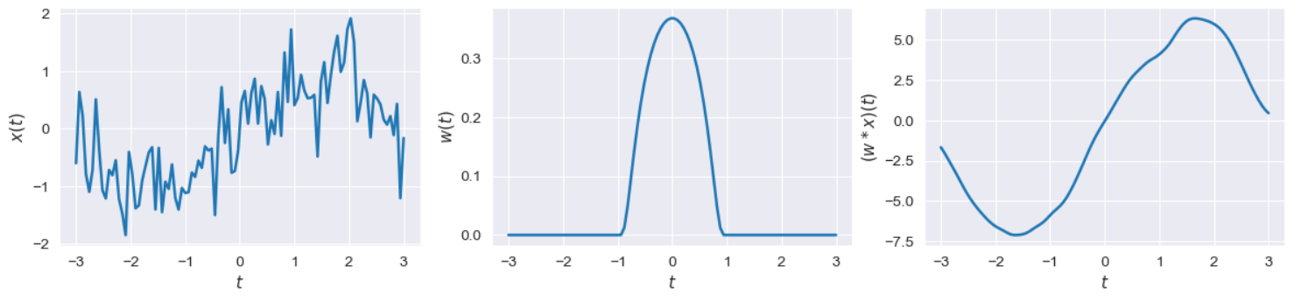
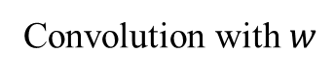
What do convolutions do?
Convolution with $w$
Convolution with a smooth bump smooths out the signal.
Is this the only thing convolutions can do?

Slide 15
Discrete Convolutions
Real signals are rarely truly continuous
Inherently discrete
Discrete samples from continuous data
In fact, often discrete samples are enough to reconstruct continuous signals, as long as the latter is band-limited! [Shannon, 1949].

Slide 16
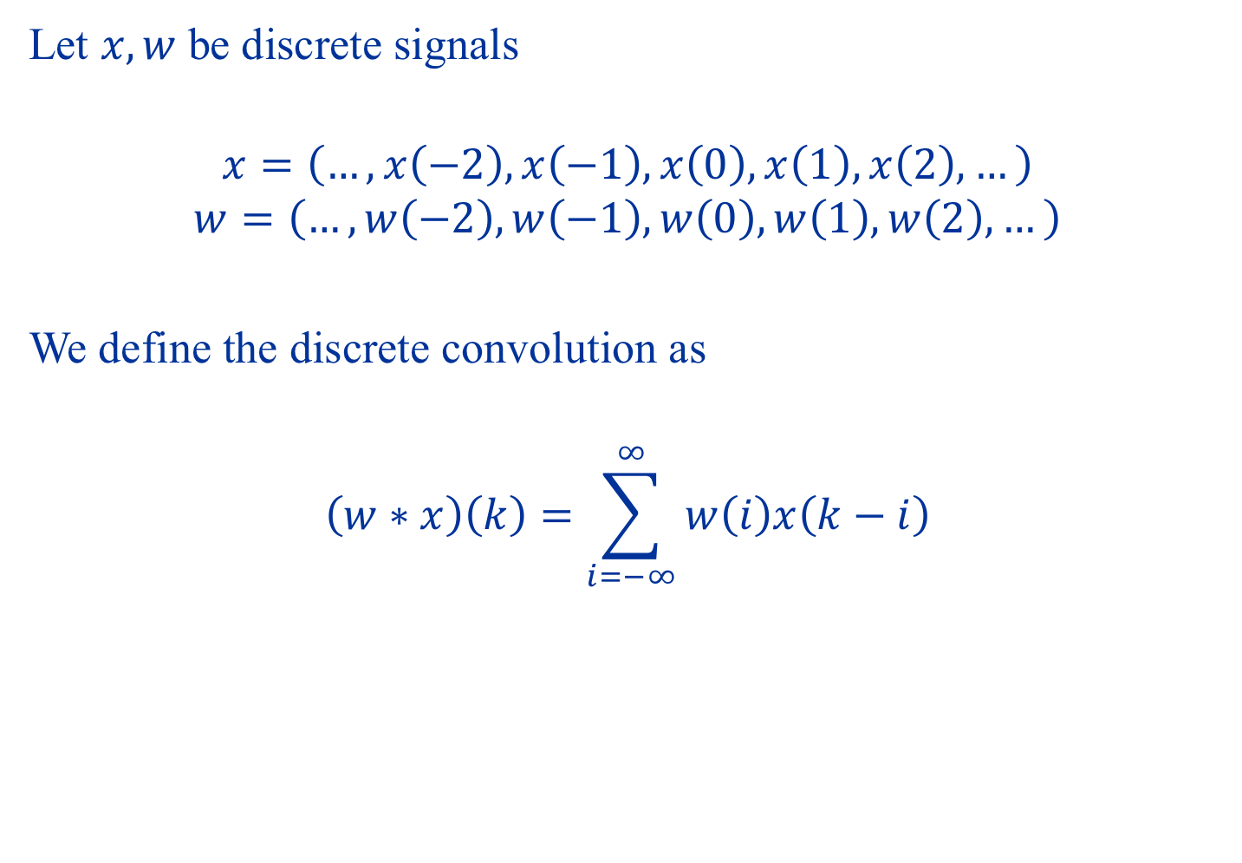
Discrete Convolutions
Let $x,w$ be discrete signals
$$x=\left(…,x\left(−2\right),x\left(−1\right),x\left(0\right),x\left(1\right),x\left(2\right),…\right)$$
$$w=\left(…,w\left(−2\right),w\left(−1\right),w\left(0\right),w\left(1\right),w\left(2\right),…\right)$$
We define the discrete convolution as
$$\left(w∗x\right)\left(k\right)=\sum_{i=−∞}^{∞}{w\left(i\right)x\left(k−i\right)}$$

Slide 17
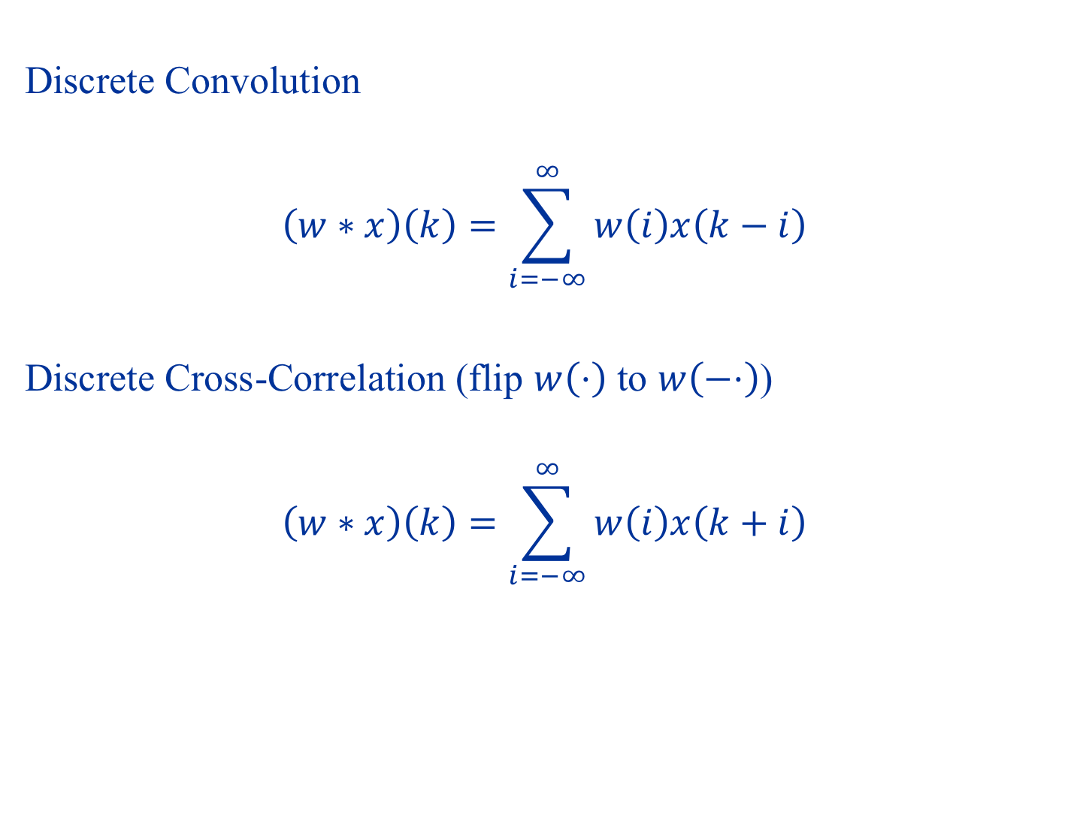
Convolution vs Cross-Correlation
Discrete Convolution
$$\left(w∗x\right)\left(k\right)=\sum_{i=−∞}^{∞}{w\left(i\right)x\left(k−i\right)}$$
Discrete Cross-Correlation (flip $w\left(⋅\right)$ to $w\left(−⋅\right)$)
$$\left(w∗x\right)\left(k\right)=\sum_{i=−∞}^{∞}{w\left(i\right)x\left(k+i\right)}$$

Slide 18
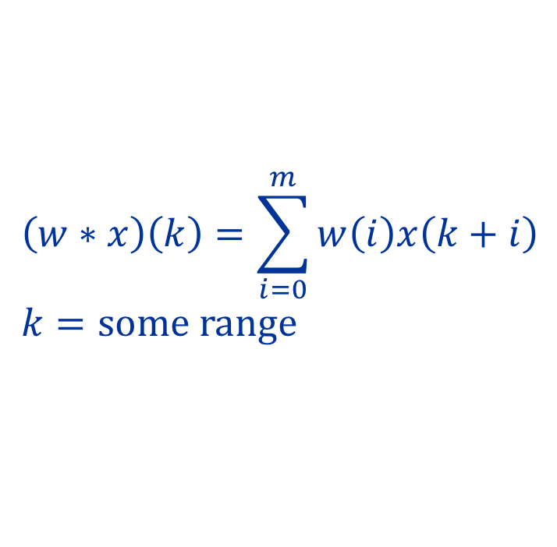
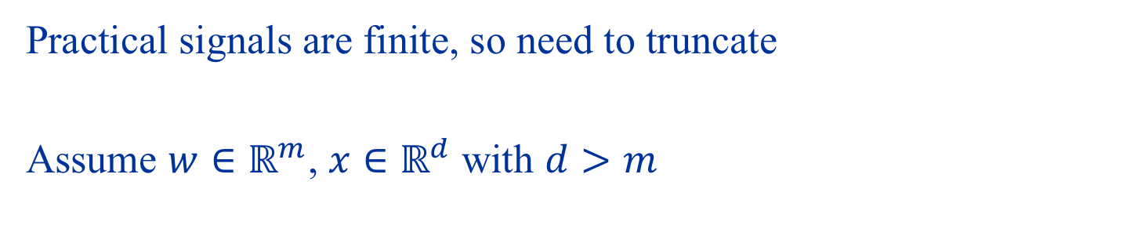
Finite Convolutions and Boundary Conditions
Practical signals are finite, so need to truncate
Assume $w∈ℝ^{m}$, $x∈ℝ^{d}$ with $d>m$
$$\left(w∗x\right)\left(k\right)=\sum_{i=0}^{m}{w\left(i\right)x\left(k+i\right)} \\ k=some range$$

Slide 19
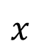
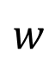
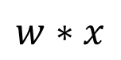
Finite Convolutions and Boundary Conditions
Practical signals are finite, so need to truncate
Circular convolutions
$$w$$
1
2
1
$$x$$
5
3
1
4
1
5
3
$$w∗x$$
12
9
10
11
14

Slide 20
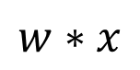
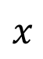
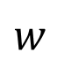
Finite Convolutions and Boundary Conditions
Practical signals are finite, so need to truncate
Valid convolutions
$$w$$
1
2
1
$$x$$
3
1
4
1
5
$$w∗x$$
9
10
11

Slide 21
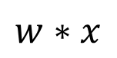
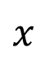
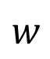
Finite Convolutions and Boundary Conditions
Practical signals are finite, so need to truncate
Zero-Padded convolutions with “same” padding
$$w$$
1
2
1
$$x$$
0
3
1
4
1
5
0
$$w∗x$$
7
9
10
11
10

Slide 22
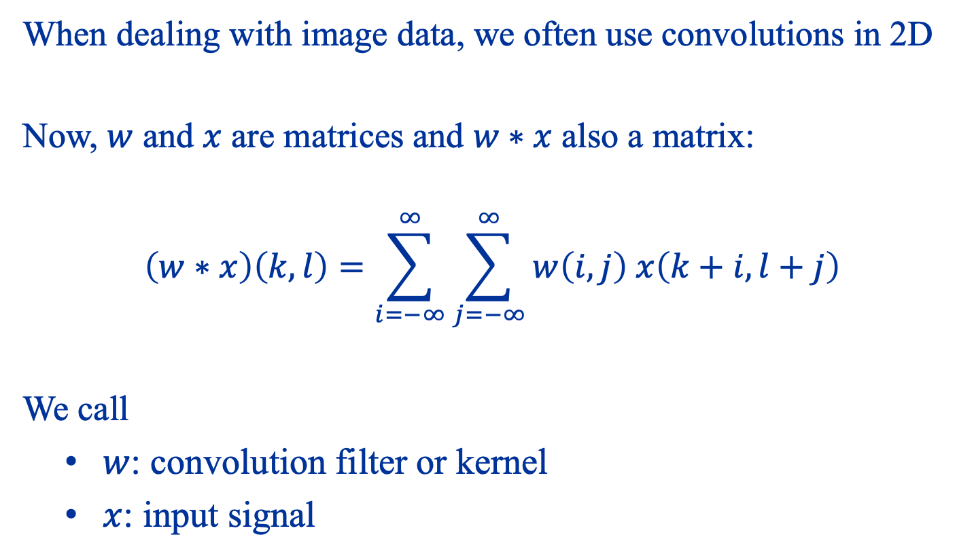
Convolution in 2D
When dealing with image data, we often use convolutions in 2D
Now, $w$ and $x$ are matrices and $w∗x$ also a matrix:
$$\left(w∗x\right)\left(k,l\right)=\sum_{i=−∞}^{∞}{\sum_{j=−∞}^{∞}{w\left(i,j\right) x\left(k+i,l+j\right)}}$$
We call
$w$: convolution filter or kernel
$x$: input signal

Slide 23

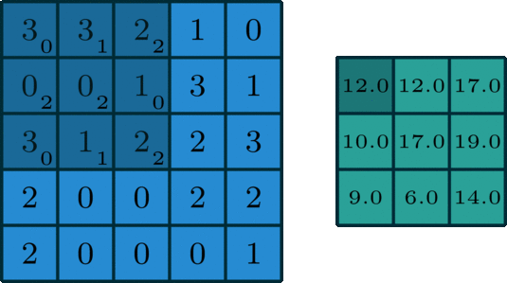
Example: Convolutions in 2D
https://towardsdatascience.com/intuitively-understanding-convolutions-for-deep-learning-1f6f42faee1

Slide 24
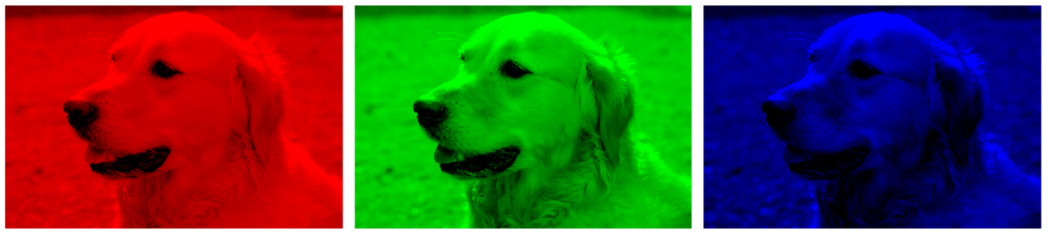
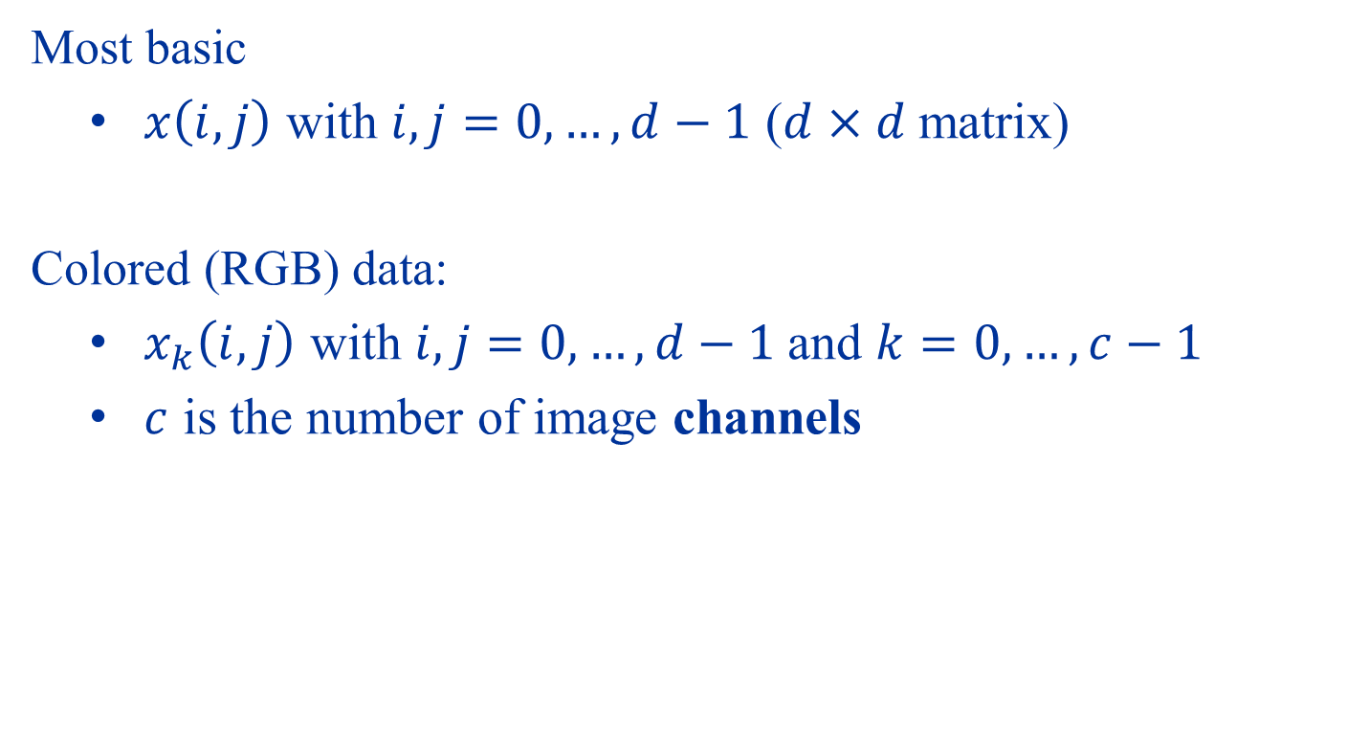
Image Input Data
Most basic
$x\left(i,j\right)$ with $i,j=0,…,d−1$ ($d×d$ matrix)
Colored (RGB) data:
$x_{k}\left(i,j\right)$ with $i,j=0,…,d−1$and $k=0,…,c−1$
$c$ is the number of image channels

Slide 25
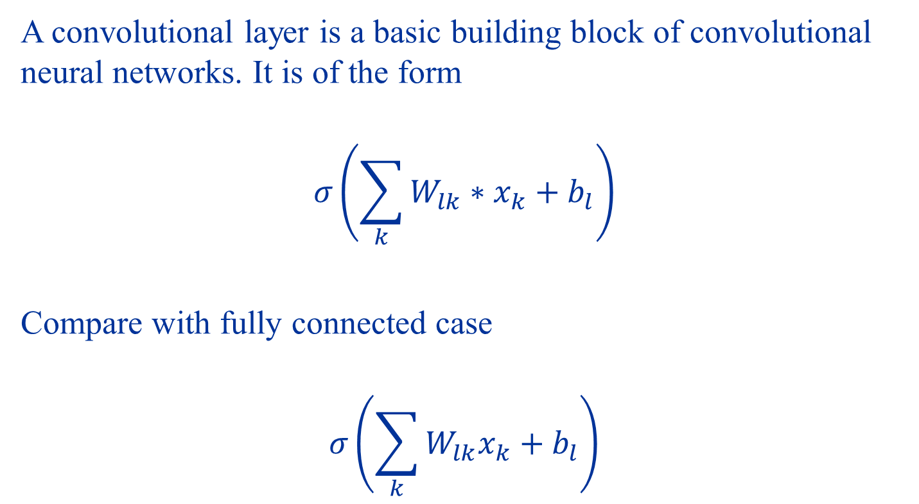
Convolutional Layer
A convolutional layer is a basic building block of convolutional neural networks. It is of the form
$$σ\left(\sum_{k}{W_{lk}∗x_{k}+b_{l}}\right)$$
Compare with fully connected case
$$σ\left(\sum_{k}{W_{lk}x_{k}}+b_{l}\right)$$

Slide 26
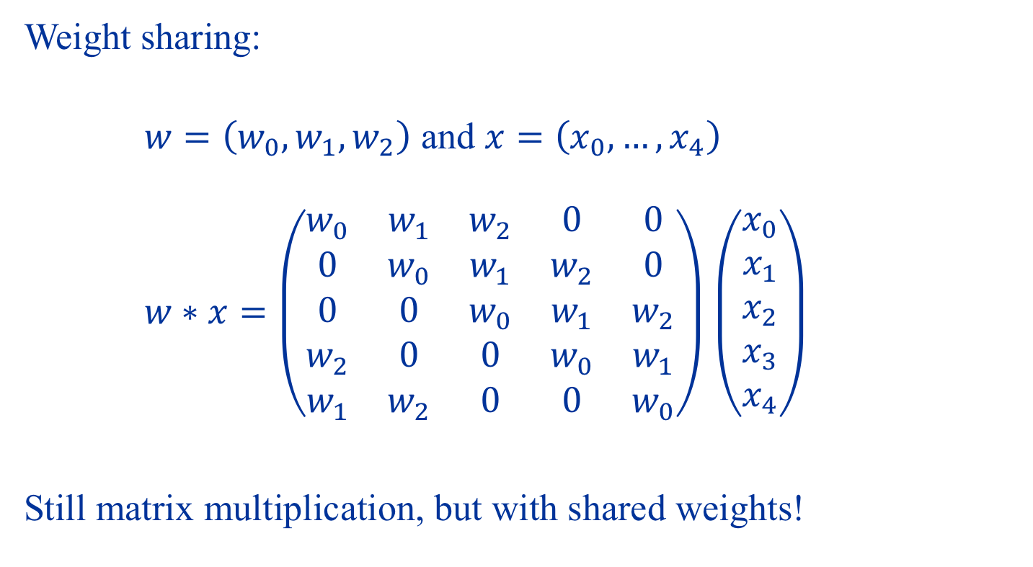
Why Convolutions?
Weight sharing:
$w=\left(w_{0},w_{1},w_{2}\right)$ and $x=\left(x_{0},…,x_{4}\right)$
$w∗x=\left(\begin{matrix}w_{0} & w_{1} & w_{2} & 0 & 0 \\ 0 & w_{0} & w_{1} & w_{2} & 0 \\ 0 & 0 & w_{0} & w_{1} & w_{2} \\ w_{2} & 0 & 0 & w_{0} & w_{1} \\ w_{1} & w_{2} & 0 & 0 & w_{0}\end{matrix}\right)$ $\left(\begin{matrix}x_{0} \\ x_{1} \\ x_{2} \\ x_{3} \\ x_{4}\end{matrix}\right)$
Still matrix multiplication, but with shared weights!

Slide 27
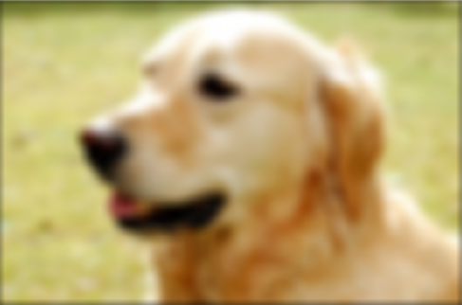
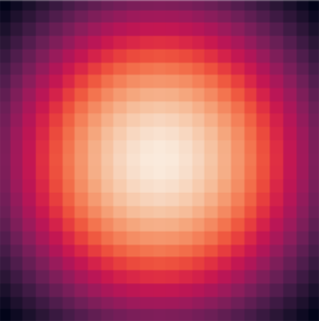
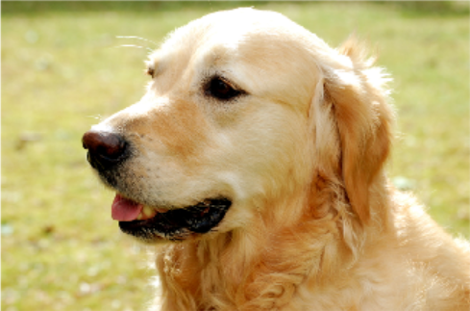
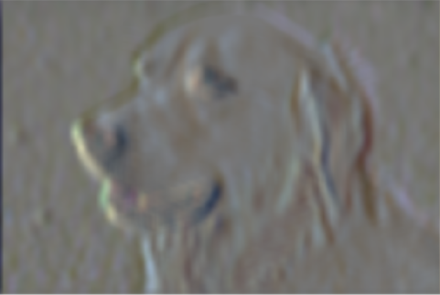

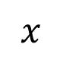
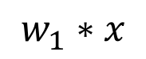
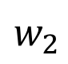
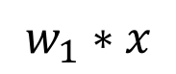
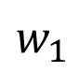
Effective Feature Extractors
$$w_{1}∗x$$
$$w_{1}$$
$$x$$
$$w_{1}∗x$$
$$w_{2}$$

Slide 28
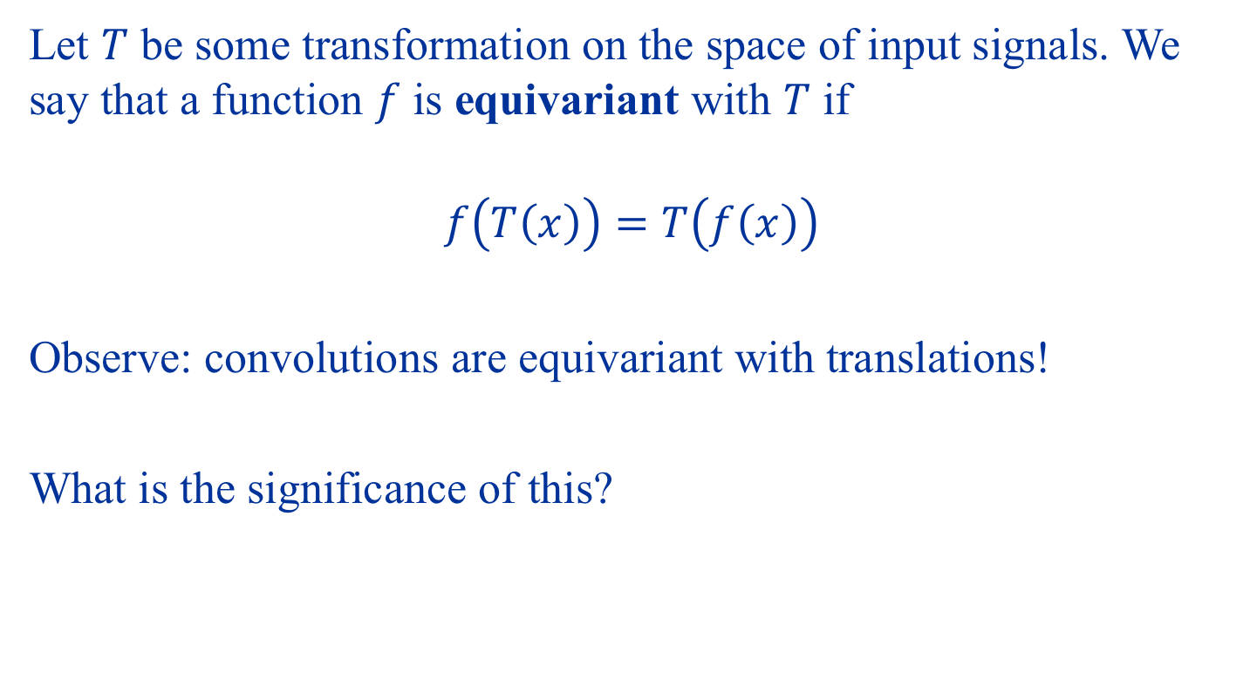
Equivariance
Let $T$ be some transformation on the space of input signals. We say that a function $f$ is equivariant with $T$ if
$$f\left(T\left(x\right)\right)=T\left(f\left(x\right)\right)$$
Observe: convolutions are equivariant with translations!
What is the significance of this?

Slide 29
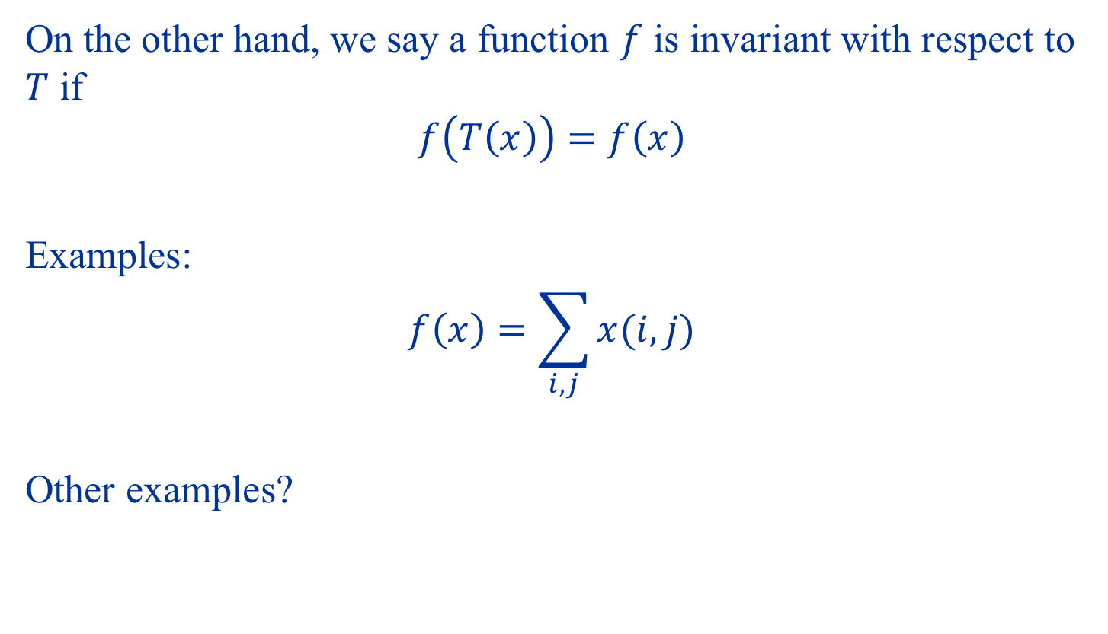
Invariance
On the other hand, we say a function $f$ is invariant with respect to $T$ if
$$f\left(T\left(x\right)\right)=f\left(x\right)$$
Examples:
$$f\left(x\right)=\sum_{i,j}{x(i,j)}$$
Other examples?

Slide 30
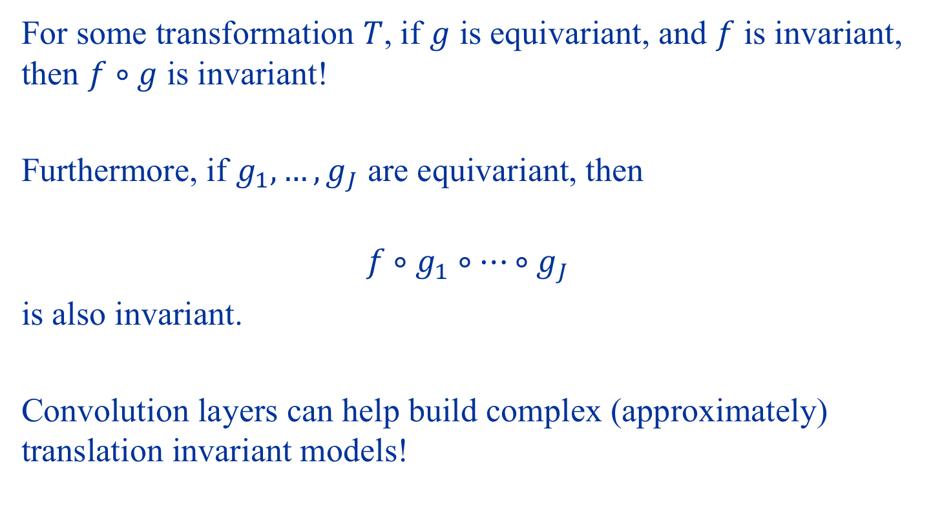
Equivariance and Invariance
For some transformation $T$, if $g$ is equivariant, and $f$ is invariant, then $f∘g$ is invariant!
Furthermore, if $g_{1},…,g_{J}$ are equivariant, then
$$f∘g_{1}∘…∘g_{J}$$ is also invariant.
Convolution layers can help build complex (approximately) translation invariant models!

Slide 31
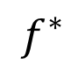
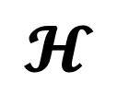
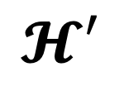
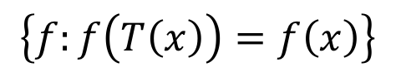
Shrinking/Focusing the Hypothesis Space
$$f^{∗}$$
$$𝓗$$
$$\left\{f:f\left(T\left(x\right)\right)=f\left(x\right)\right\}$$
$$𝓗′$$

Slide 32
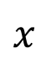
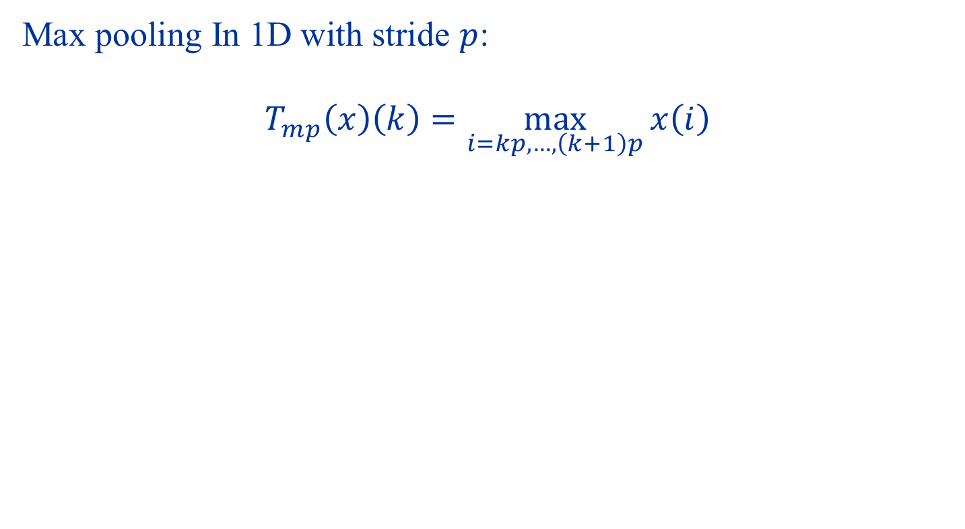



Pooling Layers
Max pooling In 1D with stride $p$:
$$T_{mp}\left(x\right)\left(k\right)=\max_{i=kp,…,\left(k+1\right)p}{x\left(i\right)}$$
$$x$$
$$x$$
3
1
4
1
3
1
4
1
5
9
5
9
2
6
$T_{mp}\left(x\right)$
5
3
5
8
9
6
3
4
9
$T_{mp}\left(x\right)$
9
7
9
3
9
9

Slide 33





A Typical CNN Architecture
Conv 1
$3×3$ Filters
Conv 2
$3×3$ Filters
Flatten
FCNN
$$\left(\begin{matrix}0.9 \\ 0.1\end{matrix}\right)$$
Max Pool
$$2×2$$
Max Pool
$$2×2$$

Slide 34
Demo: CNNs for Image Classification

Slide 35
Summary
→ Convolution Neural Networks
Suitable for data with spatial structure (e.g. images)
Convolution and pooling builds equivariance, invariance
→ What about text data?
Recurrent Neural Networks (short lecture after mid-term)
Suitable for data with temporal structure (e.g. text, time series)
They can build powerful models!

Slide 36
Test
Style: similar to homework 2
Duration: 1 hour 30 mins
Date and time: 2:00pm to 3:30pm on 1 Oct 2022 (details will be sent next week)
A short online lecture (on Zoom) will follow the test (between 4pm-5pm)
Practice: test questions/answers from last year will be uploaded in the next few days.

